Slide 1
GIS and Spatial Analytics QMSS 5070
Lecture 6

Slide 2
Introduction to Spatial Area and Descriptive Statistics
Spatial Area: The physical size of a polygon (e.g., census tract, city boundary).
Descriptive Statistics: Measures such as mean, median, standard deviation for variables associated with polygons (e.g., population, income).

Slide 3
Using Summary Statistics in Spatial Analysis
Spatial Summary Applications:
Understand geographic distribution of income, population, etc.
Identify clusters or areas with high/low attribute values.
Compare areas (e.g., rural vs. urban).

Slide 4
Frequency
Produces a list of the unique code occurrences and their frequency in an output table for a specified set of fields from an input feature class or table.
Optionally, summary items may be totaled for each unique code combination—for example, the total area for unique combinations of zoning and land use.

Slide 5
Statistics Tools
Frequency
Summary Statistics

Slide 6
Summary Statistics
Generates summary statistics for fields from an input table or feature class and saves them in an output table.
This tool contains the following statistics types: sum, mean, minimum, maximum, standard deviation, range, first value, and last value.

Slide 7
R Resources
Resources and Further Reading
Useful Resources:
R Spatial Cheat Sheet
sf Package Documentation
dplyr Package Documentation
tmap Package Documentation

Slide 8
Required R Packages
Key Packages:
sf: For handling and manipulating spatial data.
dplyr: For data manipulation and summarization.
tmap: For visualization.

Slide 9

Loading Spatial Data in R Step 1: Import Polygon Data (Shapefiles):
Load the CSV File
Load the CSV file using read.csv(). This file contains the attributes you want to join to the spatial data (e.g., population, income, etc.).

Slide 10
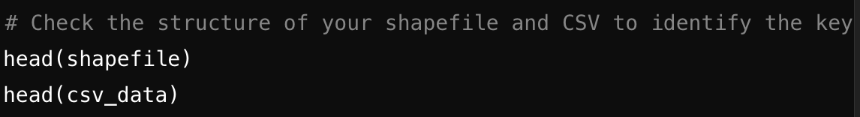
Merging Spatial JOIN Between ShapEFILe and CSV
Here's how to merge a spatial join between a shapefile and a CSV file in R, typically done when you want to enrich your spatial data (e.g., polygons from a shapefile) with attribute data (e.g., demographic data from a CSV file).
To merge the data, both the shapefile and CSV must have a common key (e.g., a GEOID, FIPS code, or census tract ID). Make sure this column exists in both datasets and that they are named consistently.
Shapefile's key: Typically a unique identifier for each spatial feature.
CSV file's key: The corresponding identifier to join data on.

Slide 11
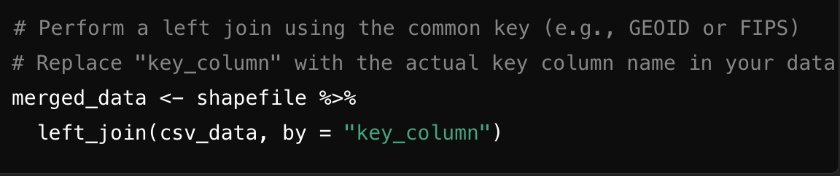

Spatial JOiNs
Now, use the left_join() function from the dplyr package to merge the attribute data (CSV) with the spatial data (shapefile).
You need to specify the common key in both datasets.

Slide 12
Visualize the Merged Data
Now that the shapefile is enriched with the CSV data, you can visualize the data using tmap or ggplot2. For example, create a thematic map using a variable from the CSV
library(tmap) # Create a thematic map using a variable from the merged data tm_shape(merged_data) + tm_polygons("population_density", palette = "Blues", title = "Population Density")

Slide 13
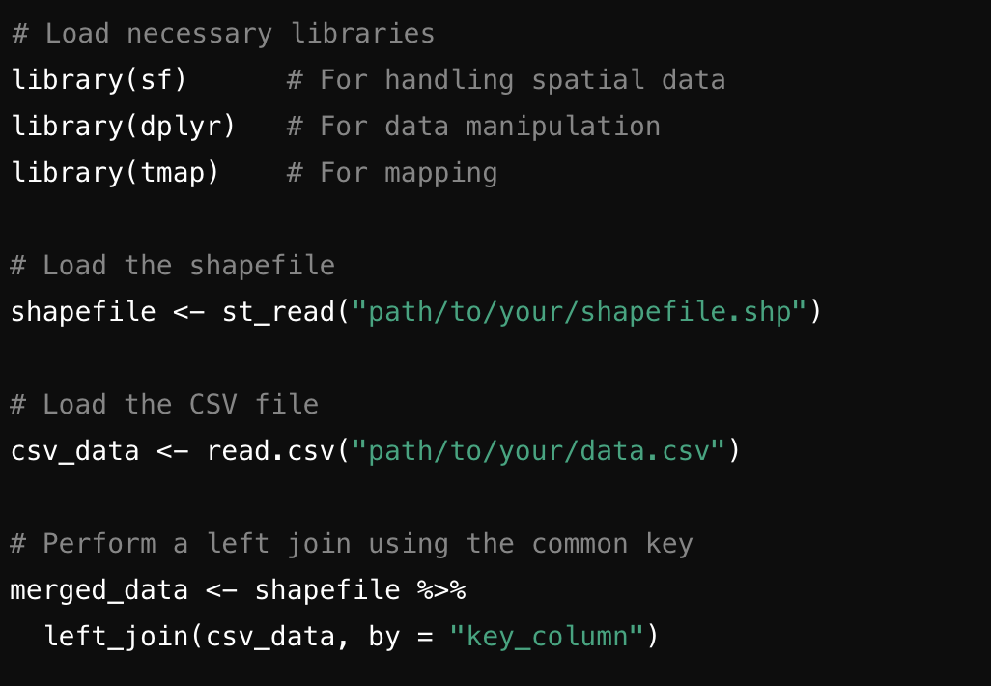
Full R CODe From IMPORT to MAPPING

Slide 14
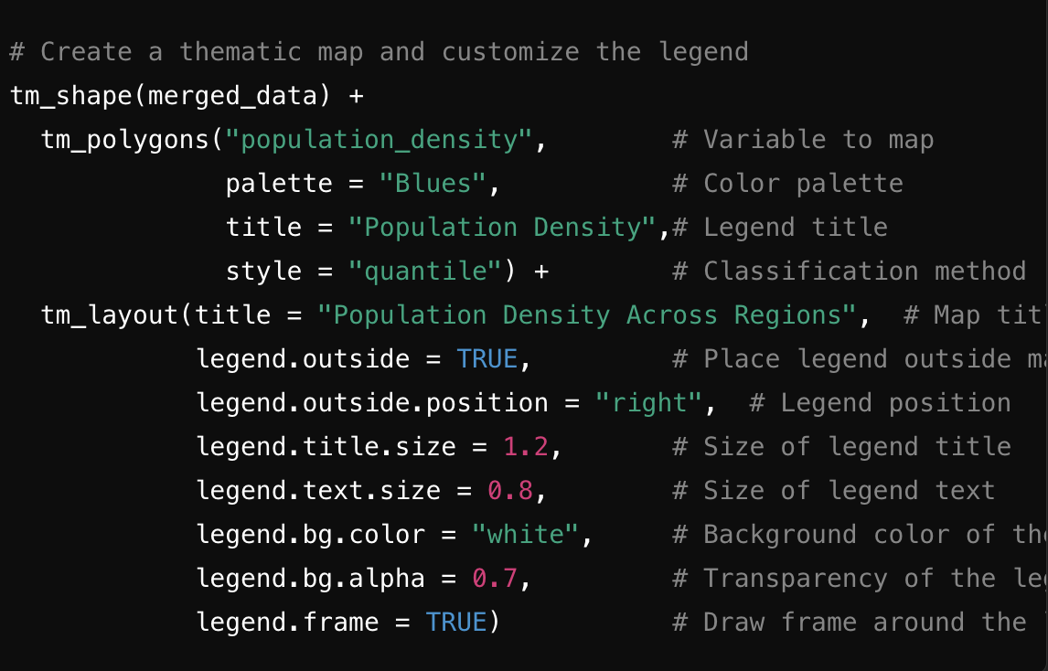
Mapping in TMAP

Slide 15
Summary of Spatial Mapping in R
Load the spatial shapefile and CSV file.
Identify the common key (e.g., GEOID or FIPS code).
Merge the CSV data into the shapefile using left_join() from dplyr.
Visualize or analyze the merged spatial data.

Slide 16
GEOCODING in R
Set Up Google Maps API Key To geocode using ggmap, you need an API key from the Google Cloud Platform. Follow these steps to get a key:
Go to the Google Cloud Console.
Create a project.
Enable the Geocoding API and Maps JavaScript API.
Create credentials for an API key.

Slide 17
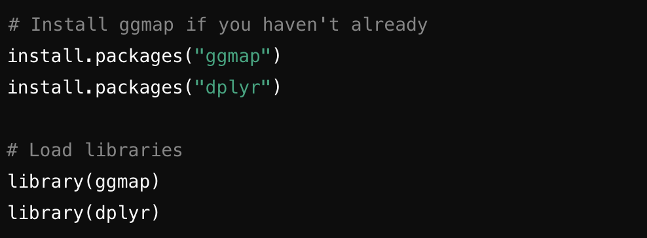
To geocode in R, you can use the ggmap package, which allows you to convert addresses into geographic coordinates (latitude and longitude) using the Google Maps API. Below is the step-by-step guide and code for geocoding addresses in R.

Slide 18
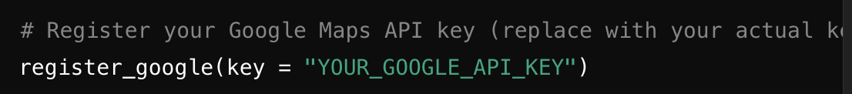
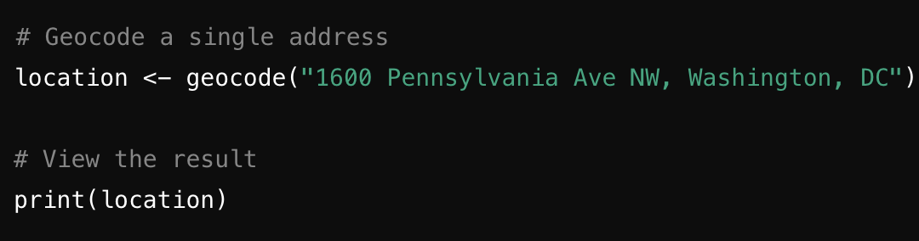
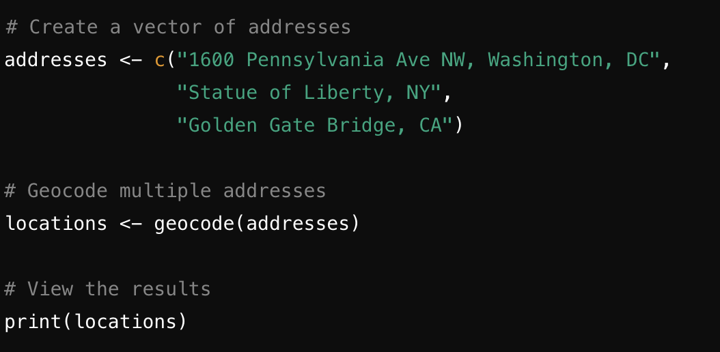
Singe Addresses and Multiple Addresses

Slide 20
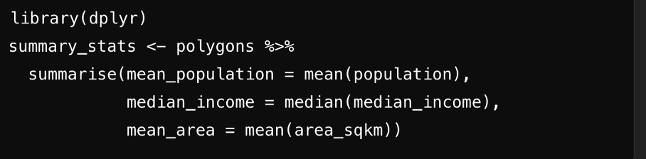
Calculating Mean and Median Values in R
Calculating Mean and Median Values
Using dplyr to Calculate Summary Statistics:
Result:
Mean population, median income, and mean area of polygons.

Slide 21
Conclusion
Key Takeaways:
Calculating polygon areas and descriptive statistics in R is straightforward with packages like sf and dplyr.
Use thematic maps to visualize and communicate findings.
Next Steps: Try applying these techniques to your own spatial datasets for deeper insights.

